Slide 1
Additional Material for Project Development
CS 420/620 HCI
Fall 2019

Slide 2
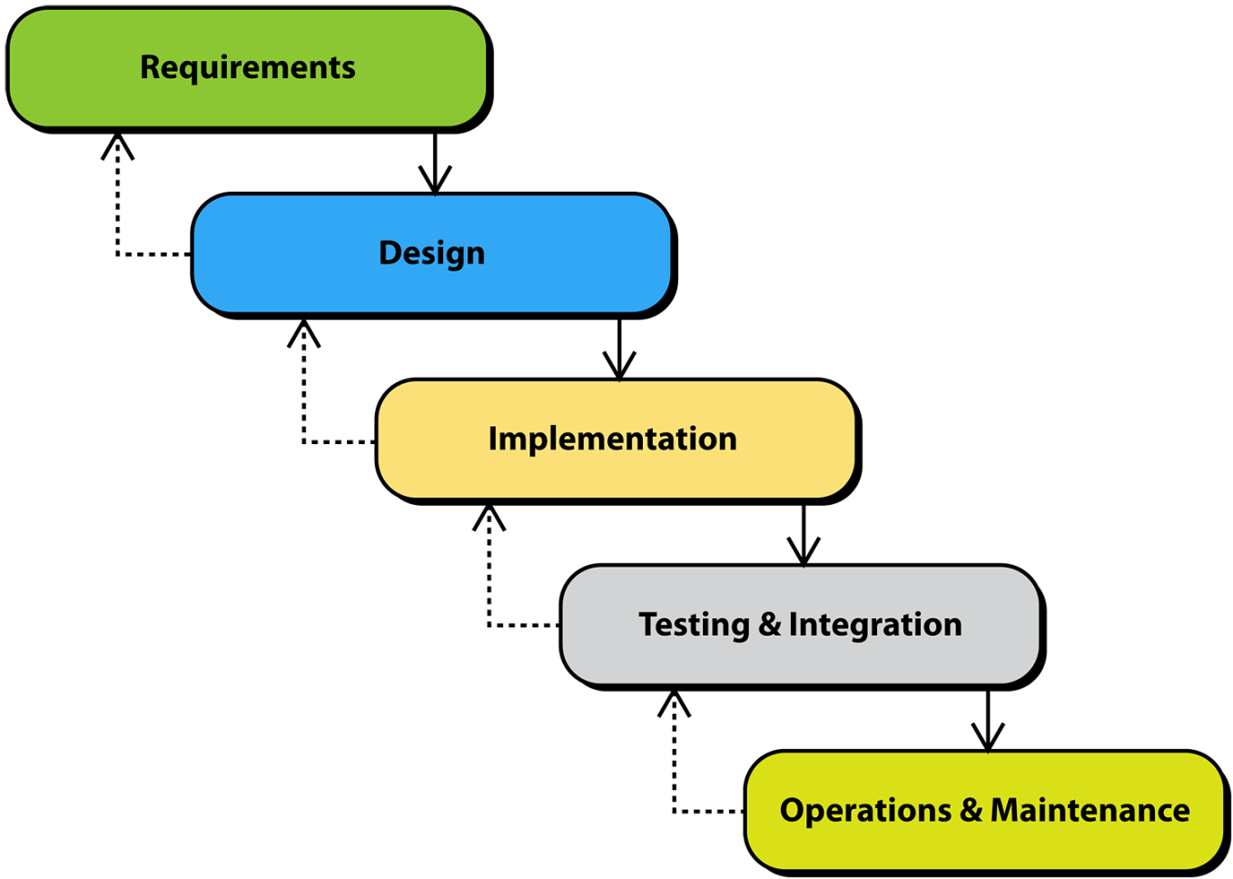
+ [Heim 2007] SE Development Process: Waterfall Model
Traditional SE model (waterfall)
Emphasis is on systematic, step-wise development
Applicable when requirements are well-known
Does not cope well with changes

Slide 3
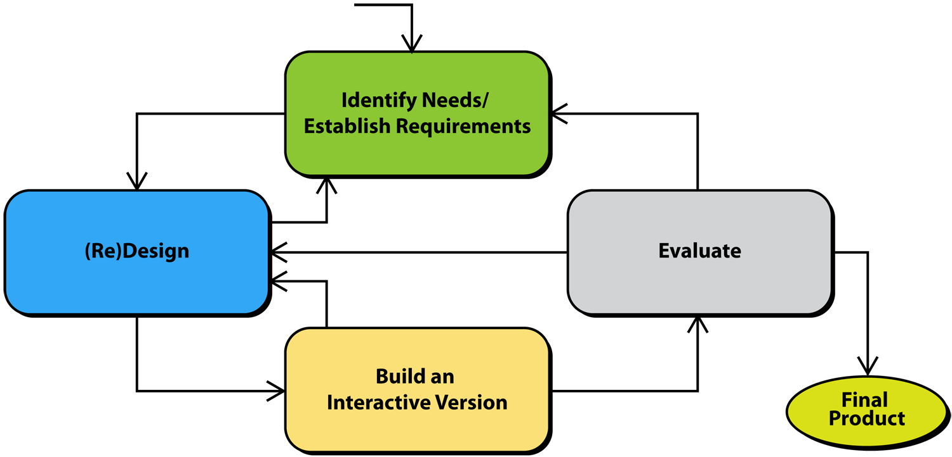
+ [Preece et al,2007] HCI Development Process: Basic Model
Typical HCI model. Note that emphasis is on iteration, evaluation, and alternative versions.

Slide 4
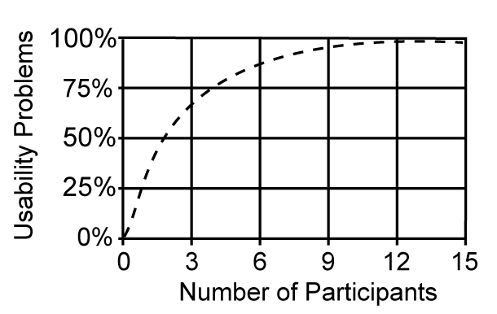
+ [Heim 2007] HCI DUE: Discount Usability Engineering
Nielsen suggested that the number of problems P that could be identified from a usability test with n users can be calculated according to the following equation:
P = N [1-(1-L)^{n}]
where:
N = total number of usability problems in a design
L = proportion of usability problems discovered with a single participant (31%)
n = number of users

Slide 5
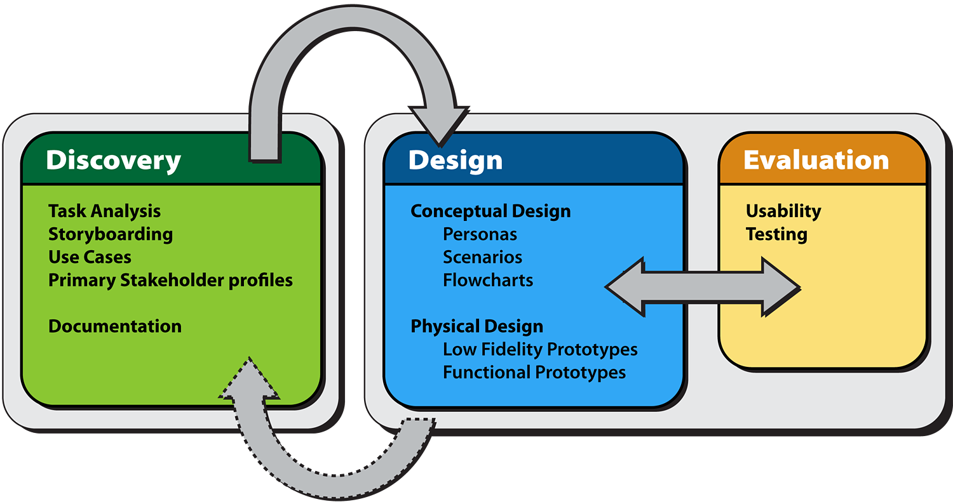
+ [Heim 2007] HCI Development Process: DDE Framework
DDE (Discovery, Design, Evaluation) Framework

Slide 6
Additional references
- Heim, S., The Resonant Interface: HCI Foundations for Interaction Design, Addison-Wesley, 2007.
- Jennifer Preece, Yvonne Rogers, and Helen Sharp, Interaction Design: Beyond Human-Computer Interaction, Wiley & Sons, 2007.

